Slide 1
Memory System
Instructor: Saba Iqbal

Slide 2
Memory
It is most important part of the computer.
It is used to store data and instructions.
The personal computer contains a main memory
The main memory is also called the primary storage.
It is used to store data and instructions that are currently in use.

Slide 3
Basic Storage Units of Memory
Bit
Basic unit of storing data in computer memory
Bit stands for binary digit represented by 0 and 1
Byte
A combination of 8-bits is called byte.
The storage capacity of the memory is expressed in terms of number of bytes.

Slide 4

Basic Storage Units of Memory
Common used storage units are
1 Nibble = 4-bits
1 Byte = 8-bits
1 Kilo Byte = 1024 or $2^{10}$Bytes
1 Mega Byte = 1024 Kilo Bytes or 1,048,576 ($2^{20}$) bytes
1 Giga Byte = 1024 Mega Bytes or 1,073,741,824 ($2^{30})$ bytes
1 Tera Byte = 1024 Giga Bytes or ($2^{40}$) bytes

Slide 5
Types of Storage
Memory is primarily of two types
Volatile Memory
It is a temporary memory.
It loses its contents when computer is turned off.
Examples are RAM and Cache memory.
Non Volatile Memory
It is a permanent memory.
It does not lose its contents when computer is turned off.
ROM is an example of non-volatile memory.

Slide 6
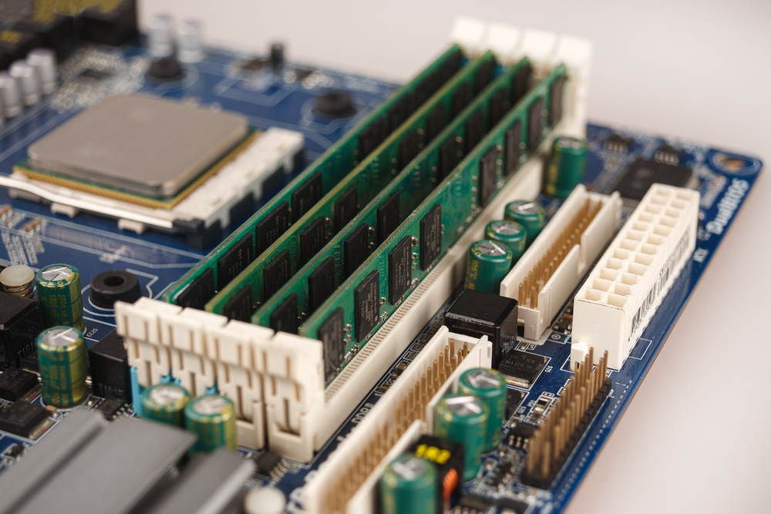
RAM (Random Access Memory)

Slide 7
RAM (Random Access Memory)
RAM is a volatile memory.
It is also referred as main memory or primary storage.
The data and program instructions are first loaded in to main memory/ RAM before execution.
The data and programs stored in RAM are lost when the electricity supply is cut-off.
The storage capacity of RAM is measured in bytes.
The large RAM size increases the accessing speed of computer.

Slide 8
RAM (Random Access Memory)
The control unit performs the following functions for main memory
Stores data and instructions (entered from input unit) into RAM
Provides the data and instructions from main memory to other parts of the computer.
Stores the processed results back into the RAM (or main memory).

Slide 9
RAM (Random Access Memory)
RAM is of two types
Static RAM (SRAM)
Dynamic RAM (DRAM)

Slide 10
Static RAM (SRAM)
It retains its contents as long as power is being supplied. Data is lost when the power gets down
It is about 10 times faster than DRAM, as it does not need not be refreshed with electric charge on a regular basis.
It has large storage space
It is expensive
SRAM is thus used as cache memory and has very fast access.

Slide 11
Dynamic RAM (DRAM)
DRAM, unlike SRAM, must be continually refreshed in order to maintain the data.
This is done by placing the memory on a refresh circuit that rewrites the data several hundred times per second.
During refreshing process, CPU has to wait for writing and reading data to and from DRAM
It is a slow memory
DRAM is used for most system memory as it is cheap and small.

Slide 12
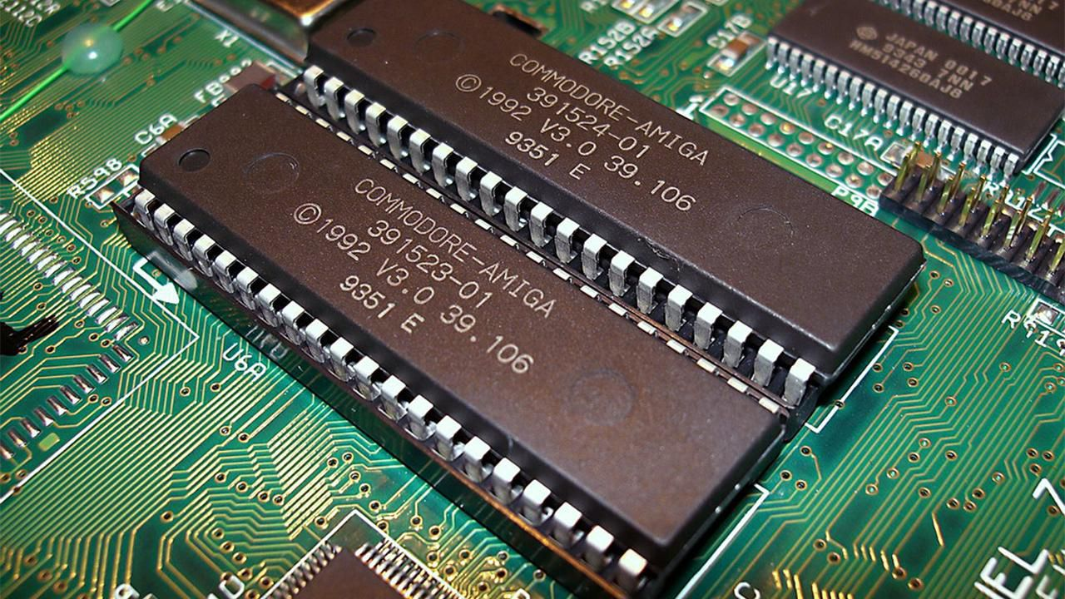
ROM (Read Only Memory)

Slide 13
ROM (Read Only Memory)
This type of memory is non-volatile.
The data and instructions stored in this type of memory can only be read but can not be changed or deleted.
It stores data and instructions permanently.
When the power is turned off, the instructions stored in ROM are not lost.
The data and instructions are written into the ROM chip at the time of its manufacturing.
When the computer is switched on, the instructions in the ROM are automatically activated. These instructions help the boot process of computer.

Slide 14
ROM (Read Only Memory)
Usually, the set of instructions stored into ROM is called Basic Input/Output System (BIOS).
It performs the following functions during the booting process of computer
Checks different units of computer system
Loads the operating system into computer memory etc.
ROM chips are not only used in the computer but also in other electronic items like washing machine and microwave oven.

Slide 15
ROM (Read Only Memory)
Types of ROM
ROM is divided into following types
PROM (Programmable Read Only Memory)
EPROM (Erasable Programmable Read Only Memory)
EEPROM (Electrically Erasable Programmable Read Only Memory)

Slide 16
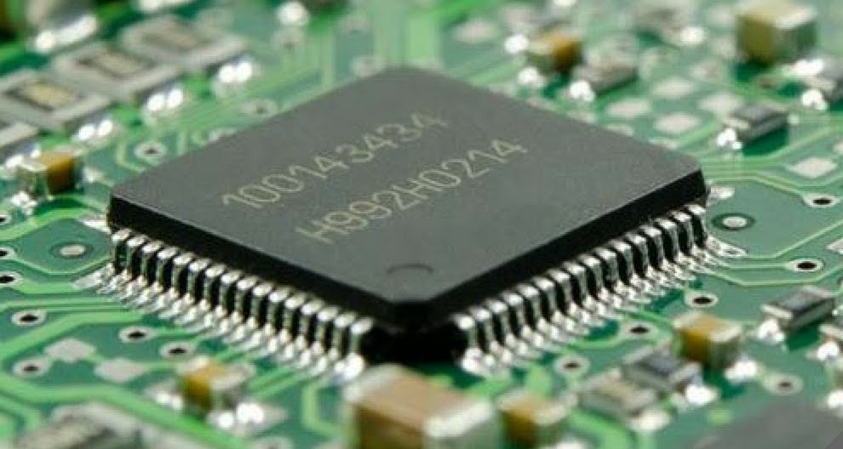
Cache Memory

Slide 17
Cache Memory
Cache memory is a very high speed semiconductor memory which can speed up the CPU.
It acts as a buffer between the CPU and the main memory.
It is used to hold those parts of data and program which are most frequently used by the CPU.
The parts of data and programs are transferred from the disk to cache memory by the operating system, from where the CPU can access them.

Slide 18
Cache Memory
Cache is graded as Level 1 (L1), Level 2 (L2) and Level 3 (L3):
L1 cache is usually part of the CPU chip itself and is both the smallest and the fastest to access. Its size is often restricted to between 8 KB and 64 KB.
L2 and L3 caches are bigger than L1. They are extra caches built between the CPU and the RAM. Sometimes L2 is built into the CPU with L1.
L2 and L3 caches take slightly longer to access than L1.
The more L2 and L3 memory available, the faster a computer can run.
Not a lot of physical space is allocated for cache.
There is more space for RAM, which is usually larger and less expensive.
Each CPU core has its own L1 cache, but may share L2 and L3 caches.

Slide 19
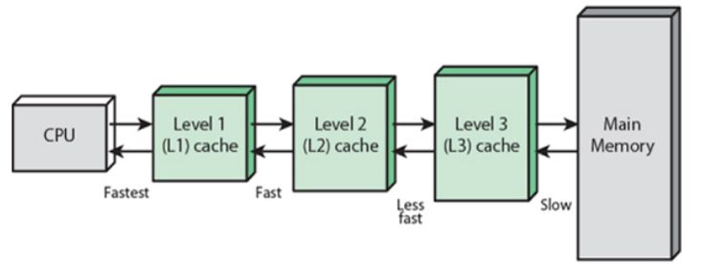
Cache Memory

Slide 20
Cache Memory
Advantages
The advantages of cache memory are as follows −
Cache memory is faster than main memory.
It consumes less access time as compared to main memory.
It stores the program that can be executed within a short period of time.
It stores data for temporary use.
Disadvantages
The disadvantages of cache memory are as follows −
Cache memory has limited capacity.
It is very expensive.

Slide 21
Lecture End

